Slide 1
U.Deekshitha
Final Project
3/21/2024 Annual Review

Slide 2
PROJECT TITLE:
KEYLOGGER AND SECURITY
3/21/2024 Annual Review

Slide 3


AGENDA
In this presentation, we will begin with an introduction, providing an overview of key loggers and
emphasizing their significance in the realm of cybersecurity. Next, we will delve into the definition of key
loggers, distinguishing between software-based and hardware-based types. Following this, we will explore
the varioustypes of key loggers, detailing the differences between software-based key loggers, such as kernel
and API-based, and hardware-based key loggers, like keyboard hardware and external devices. We will then
explain how key loggers work, covering the mechanisms of capturing keystrokes and
how this data is transmitted to attackers. The potential impacts of key loggers will be
examined, highlighting personal risks such as identity theft and financial loss, as well
as corporate risks including data breaches and intellectual Property theft,and the
wider implications for privacy and trust. We will discuss how to detect key loggers,
identifying symptoms and using detection tools,methods and prevention strategies.
3/21/2024 Annual Review

Slide 4

PROBLEM STATEMENT
The growing threat of key loggers poses significant risks to personal privacy, financial security, and organizational integrity. As cyber attackers increasingly use sophisticated key logging techniques to capture sensitive information such as passwords, credit card details, and confidential business data, individuals and organizations must enhance their understanding and implementation of effective security measures. This presentation aims to highlight the mechanisms of key loggers, their potential impacts, and the necessary steps to detect, prevent, and respond to key logger attacks, thereby fostering a more secure digital environment.
3/21/2024 Annual Review

Slide 5

PROJECT OVERVIEW
This presentation, "Key Loggers and Security," is designed to provide a comprehensive understanding of key loggers, their impact, and strategies to protect against them. We will start with an introduction to key loggers, defining what they are and differentiating between software-based and hardware-based types. The presentation will then explore the mechanisms through which key loggers operate, how they capture keystrokes, and how this information is transmitted to attackers. We will discuss the potential impacts of key loggers, from personal risks like identity theft and financial loss to corporate risks including data breaches and intellectual property theft. We will learn detection of key loggers, examining symptoms, indicators, and the tools available for identifying them. We also learn preventive measures and advanced security measures will also be highlighed.
3/21/2024 Annual Review

Slide 6

WHO ARE THE END USERS?
The primary end users of this presentation on "Key Loggers and Security" are:
1)Individuals and General Public
2)Corporate Employees and Management
3)IT and Security Professionals
4)Educational Institutions and Students
5)Government and Law Enforcement Agencies
6)Healthcare Providers
3/21/2024 Annual Review

Slide 7

YOUR SOLUTION AND ITS VALUE PROPOSITION
My strategy against key loggers is comprehensive, integrating education, advanced detection tools, preventive measures, and robust incident response plans. We prioritize awareness through regular training and materials, emphasizing safe online practices. Advanced anti-malware software and real-time monitoring bolster detection and removal. We advocate for software updates, multi-factor authentication, and encryption to thwart vulnerabilities. Clear incident response protocols, supported by real-world case studies, ensure effective action upon detection.
3/21/2024 Annual Review

Slide 8

THE WOW IN YOUR SOLUTION
Unlocking Security: Our solution presents a paradigm shift in combating keylogger threats,weaving together innovative defenses to safeguard your digital world. Witness the 'wow' as we elevate awareness, fortify defenses, and ensure rapid response, setting a new standard in cyber protection. Experience peace of mind, fortified finances, and fortified reputations – all within reach through our revolutionary security framework.
3/21/2024 Annual Review
8

Slide 9
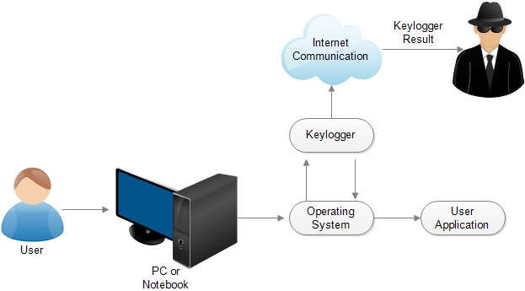
MODELLING
Architecture Overview:
Modular Design: The keylogger code is structured into modular functions for better readability and maintenance.
Event Handling: Utilizes the pynput library to capture and handle keyboard events.
Data Logging: Implements functions to log captured data into text and JSON files.
Components:
. Key Press Handling: Function: on_press(key)
. Key Release Handling: Function: on_release(key)
Logging Functions:
. Text Logging: generate_text_log(key)
. JSON Logging: generate_json_file(keys_used)
3/21/2024 Annual Review
9

Slide 10
RESULTS
Our multifaceted security strategy significantly reduces keylogger attack risks.
Enhanced awareness and preparedness empower users to identify and avoid threats. With advanced detection tools and proactive measures, we ensure robust protection, complemented by clear incident response plans for swift action. The result is peace of mind, cost savings, reduced risk,and enhanced trust, effectively safeguarding financial and reputational integrity.
“Block Keyloggers, Boost Security.”
3/21/2024 Annual Review
10

